Slide 1
Dockerizing FastAPI Application
Data Science and AI with MathmaticalMind(Maryam)
@Maryam.Anwar786
Docker Deploy: FastAPI Docker Deploying
Let's go 🚀
https://github.com/anwarsiraj1234
Kindly follow my GitHub account.

Slide 2
Dockerizing FastAPI Application
If you don't have a FastAPI application, you must be ready with Fast API Application. Follow this tutorial.
To create a FastAPI Application
First, create a virtual environment for your project.
$ virtualenv venv
Note: If you don’t have virtualenv package in your system, install it by $
pip install virtualenv
Activate your virtual environment by
$ ./venv/Scripts/activate or $ source venv/bin/activate
3.Install the required package for FastAPI application.
pip install fastapi
pip install "uvicorn[standard]"

Slide 3
4. Create a new app.py file in your project folder.
from fastapi import FastAPI
app = FastAPI()
@app.get("/")
def hello():
return {"Hello": "World"}
if __name__ == '__main__':
import uvicorn
uvicorn.run(app, port=8000)
5. To run this app by $ uvicorn app:app
To Dockerizing the FastAPI
First, get the packages into requirements.txt by
$ pip freeze > requirements.txt

Slide 4
6. Now, Let's create a Dockerfile file in the project folder.
Add this code
FROM python:3.11-slim-buster
# Set the working directory in the container
WORKDIR /app
# Copy the requirements file to the container
COPY requirements.txt .
# Install dependencies
RUN pip install -r requirements.txt
# Copy the rest of the project files to the container
COPY . .
# Expose the port that the application will be running on
EXPOSE 8000
# Run the application
CMD ["uvicorn", "app:app"]

Slide 5
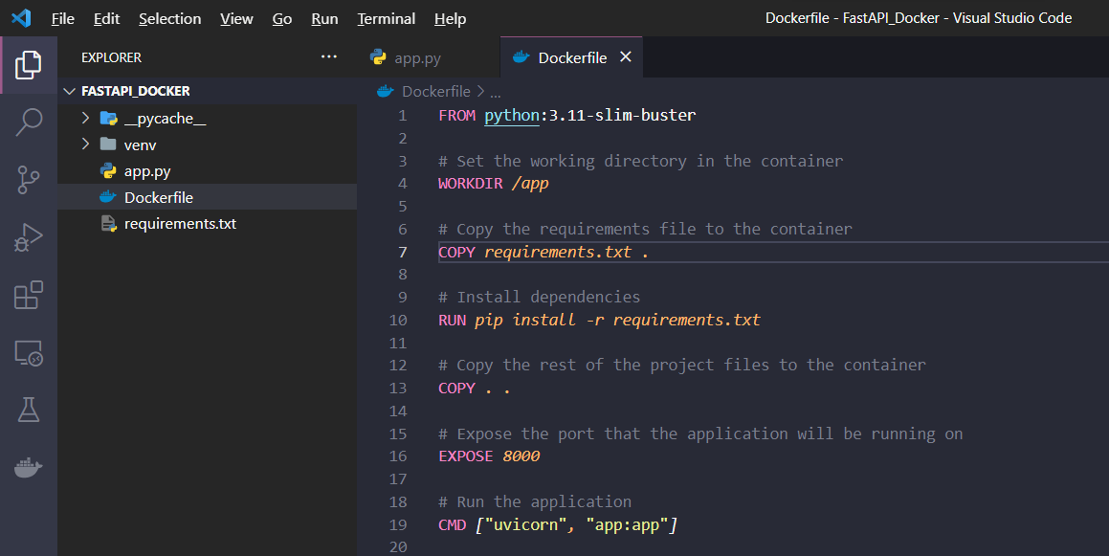
It should be like this
run the command to build an image of an application
$ docker build -t fastapi .

Slide 6
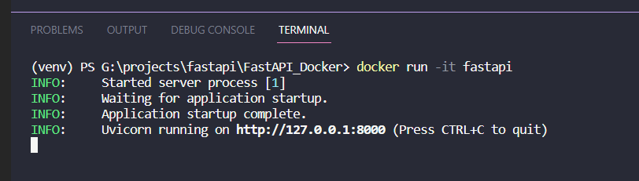
run the command to run the docker image application.
$ docker run -it fastapi
Result:

